Slide 1
Chap- 1
Introduction to Routing and Packet Forwarding

Slide 2
Routers
A router is a computer, just like any other computer including a PC.
Routers have many of the same hardware and software components that are found in other computers including:
  CPU
  RAM
  ROM
  Operating System
Routers are at the network center
  A router connects multiple networks
  It has multiple interfaces that each belong to a different IP network.
Routers Tasks
  Determining the best path to send packets -(Routing)
  Forwarding packets toward their destination -(Forwarding)

Slide 3
Although there are several different types and models of routers, every router has the same general hardware components.
CPU
The CPU executes operating system instructions, such as system initialization, routing functions, and switching functions.
RAM
RAM stores the instructions and data needed to be executed by the CPU.
RAM is used to store these components:
  Operating System: The IOS is copied into RAM during bootup.
  Running Configuration File: commands that the router IOS is currently using.
  IP Routing Table: This file stores information about directly connected and remote networks.
  ARP Cache: contains the IPv4 address to MAC address mappings,
  Packet Buffer: Packets are temporarily stored in a buffer when received on an interface or before they exit an interface.

Slide 4
ROM
ROM is a form of permanent storage.
Devices use ROM to store:
  The bootstrap instructions
  Basic diagnostic software
  Scaled-down version of IOS
Flash Memory
Flash memory is nonvolatile computer memory that can be electrically stored and erased.
Flash is used as permanent storage for the operating system.
In most models of routers, the IOS is permanently stored in flash memory and copied into RAM during the bootup process.
NVRAM
NVRAM (Nonvolatile RAM) does not lose its information when power is turned off.
Used by the IOS as permanent storage for the startup configuration file (startup-config).

Slide 5
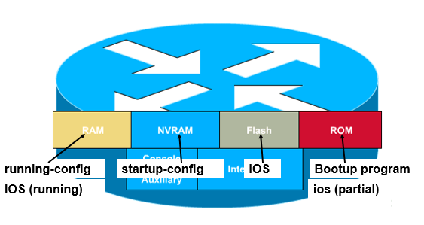

Slide 6
IOS is a multitasking operating system that is integrated with routing, switching, internetworking, and telecommunications functions.
An IOS image is a file that contains the entire IOS for the router.
IOS has its own user interface.
The command line interface (CLI) is a much more common method of configuring routers.
Upon boot up, the startup-configuration file in NVRAM is copied into RAM and stored as the running-configuration file.
IOS executes the configuration commands in the running-configuration.

Slide 7
Router interfaces
Management Ports- used to manage the router. Not used for packet forwarding.
Routers have multiple interfaces that are used to connect to multiple networks.
Every interface on the router is a member or host on a different IP network.
Router interfaces can be divided into two major groups:
  LAN interfaces - such as Ethernet and Fast Ethernet
    A router Ethernet interface usually uses an RJ-45 jack that supports unshielded twisted-pair (UTP) cabling.
  WAN interfaces - such as serial, ISDN, and Frame Relay
    WAN interfaces are used to connect routers to external networks, usually over a larger geographical distance.
    The Layer 2 encapsulation can be of different types, such as PPP, Frame Relay, and HDLC (High-Level Data Link Control)
    Each WAN interface has its own IP address and subnet mask.

Slide 8
Router interfaces and ports
Management Ports
Console port
  Terminal
  PC running terminal emulator software
No need for network access
Used for initial configuration
Auxiliary (AUX) port
Not all routers have auxiliary ports.
  At times, can be used similarly to a console port
  Can also be used to attach a modem.
Interfaces - Receive and forward packets.
  Various types of networks
  Different types of media and connectors.
  Different types of interfaces.
Fast Ethernet interfaces - LANs
Serial interfaces - WAN connections including T1, DSL, and ISDN

Slide 9
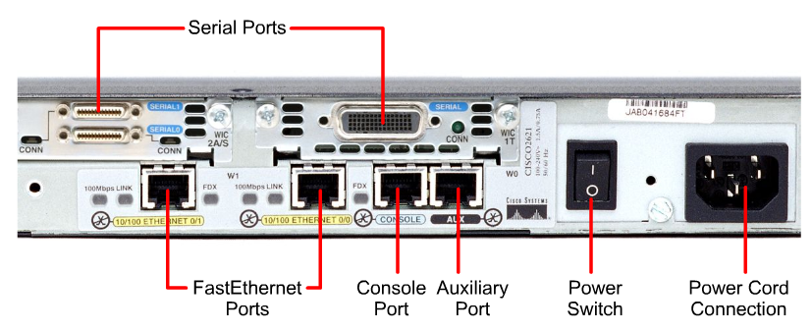
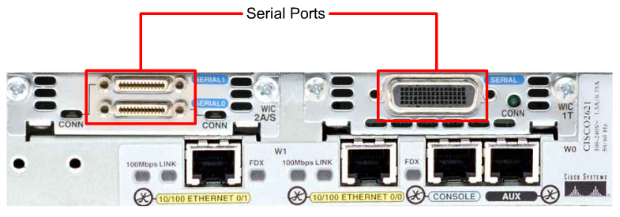
Router interfaces

Slide 10
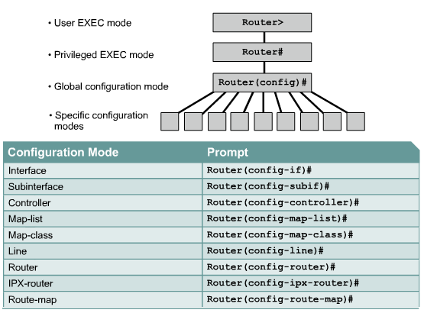
Router command modes

Slide 11
Basic router configuration
When configuring a router, certain basic tasks are performed including:
  Naming the router
  Setting passwords
  Configuring interfaces
  Configuring a banner
  Saving changes on a router
  Verifying basic configuration and router operations

Slide 12
Basic router configuration
Router> User EXEC mode
Router>enable
Router# Privileged EXEC mode
Router#config t
Router(config)# Global configuration mode
Router(config)#hostname R1
R1(config)#

Slide 13
Basic router configuration
Next, configure the console and Telnet lines with the password cisco being on global configuration mode.
  R1(config)#line console 0
  R1(config-line)#password cisco
  R1(config-line)#login
  R1(config-line)#exit
  R1(config)#line vty 0 4
  R1(config-line)#password cisco
  R1(config-line)#login
  R1(config-line)#exit
Configuring a Banner being on global configuration mode.
  R1(config)#banner motd #!! Unauthorized Access Prohibited!!# to give WARNING message

Slide 14
Cont.…
Router Interface Configuration
You will now configure the individual router interfaces with IP addresses and other information.
  Being in a global configuration mode:
  R1(config)#interface Serial0/0/0
  R1(config-if)#ip address 192.168.2.1 255.255.255.0
  R1(config-if)#no shutdown
  R1(config-if)#exit
  R1(config)#interface FastEthernet0/0
  R1(config-if)#ip address 192.168.1.1 255.255.255.0
  R1(config-if)#description R1 LAN
  R1(config-if)#no shutdown
  R1(config-if)#exit
Each Interface Belongs to a Different Network

Slide 15
Verifying basic router configuration
R1#show running-config
  Display the running configuration file on RAM.
R1#copy running-config startup-config
  save the running-config to the startup-config as the permanent configuration file.
R1#show startup-config
  displays the startup configuration file stored in NVRAM.
R1#show ip route
  displays the routing table that the IOS is currently using to choose the best path to its destination networks.
R1#show interfaces
  displays all of the interface configuration parameters and statistics.
R1#show ip interface brief
  displays abbreviated interface configuration information, including IP address and interface status.

Slide 16
Routing table
A routing table is a data file in RAM that is used to store route information about directly connected and remote networks.
It contains network/next hop associations.
Directly Connected Routes - To visit a neighbor, you only have to go down the street on which you already live.
Static Routes - A train uses the same railroad tracks every time for a specified route.
Dynamic Routes - When driving a car, you can "dynamically" choose a different path based on traffic, weather, or other conditions.
The show ip route command- the routing table is displayed with the show ip route command.

Slide 17
Routing table principles
1. Every router makes its decision alone, based on the information it has in its own routing table.
2. The fact that one router has certain information in its routing table does not mean that other routers have the same information.
3. Routing information about a path from one network to another does not provide routing information about the reverse, or return, path.

Slide 18
Chap- 2
RIP v1, v2

Slide 19
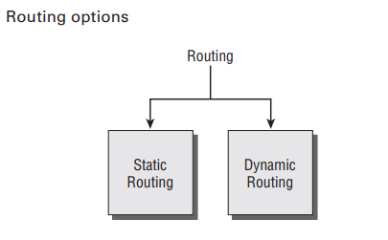
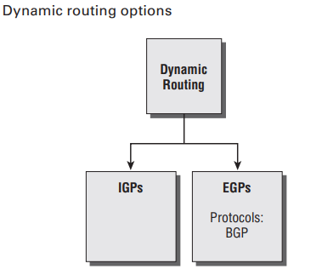

Slide 20
RIP Characteristics
(RIPv1) is the first routing protocol identifying the best path dynamically
Supports Classful routing protocol
  Does not include the subnet mask in the routing updates
Metric is hop counts selecting best path
1: directly connected
16: infinity
Routes advertised with hop counts greater than 15 are unreachable.
RIP uses distance-vector(Bellman-Ford) spf algorithm
-to calculate best path

Slide 21


Slide 22
Administrative Distance of RIP is 120.
RIPv1 is defined in RFC1058 and RIPv2 is defined in RFC 2453.
RIPv2 has the following advantages compared to RIPv1:
Subnet mask is available in route refresh
Authentication of route refresh
Multicasting route refresh
RIP uses UDP packet (Port number 520) to exchange RIP Routing information.
–IP Multicast (RIP-2): 224.0.0.9
–Broadcast (RIP-1): 255.255.255.255

Slide 23


Slide 24
RIP provides the following four types of timers:
Default values
1. Update timer-30s
2. Invalid timer-180s
3. Hold-down timer-180s
4. Flush Timer-240s

Slide 25
Disadvantages with RIP
•Slow convergence
–Changes propagate slowly
–Each neighbor only speaks ~every 30 seconds; information
propagation time over several hops is long
•Instability
–After a router or link failure RIP takes minutes to stabilize.
•Hops count may not be the best indication for w/c is the best route
•The maximum useful metric value is 15
–Network diameter must be less than or equal to 15.
•RIP uses lots of bandwidth
–It sends the whole routing table in updates.

Slide 26
Why would anyone use RIP?
–It is easy to implement
–It is generally available
–Implementations have been rigorously tested
–It is simple to configure.
–It has little overhead (for small networks)

Slide 27
Encapsulated RIP Message
Data Link Frame Header
IP Packet Header
UDP Segment Header
RIP Message
(512 Bytes; Up to 25 routes)
Notes:
5.1.2-A
[Interactive] Rollover
[Caption] Encapsulated RIP Message
[Notes]
Initial State

Slide 28
Encapsulated RIP Message
Data Link Frame Header
IP Packet Header
UDP Segment Header
RIP Message
(512 Bytes; Up to 25 routes)
Data Link Frame
MAC Destination Address = Broadcast: FF-FF-FF-FF-FF-FF
MAC Source Address = Address of sending interface
Notes:
5.1.2-B
[Interactive] Rollover
[Caption] Encapsulated RIP Message
[Notes]
None

Slide 29
Encapsulated RIP Message
Data Link Frame Header
IP Packet Header
UDP Segment Header
RIP Message
(512 Bytes; Up to 25 routes)
Data Link Frame
MAC Destination Address = Broadcast: FF-FF-FF-FF-FF-FF
MAC Source Address = Address of sending interface
IP Packet
IP Source Address = Address of sending interface
IP Destination Address = Broadcast: 255.255.255.255
Protocol field = 17 for UDP
Notes:
5.1.2-C
[Interactive] Rollover
[Caption] Encapsulated RIP Message
[Notes]
None

Slide 30
Encapsulated RIP Message
Data Link Frame Header
IP Packet Header
UDP Segment Header
RIP Message
(512 Bytes; Up to 25 routes)
Data Link Frame
MAC Destination Address = Broadcast: FF-FF-FF-FF-FF-FF
MAC Source Address = Address of sending interface
IP Packet
IP Source Address = Address of sending interface
IP Destination Address = Broadcast: 255.255.255.255
Protocol field = 17 for UDP
UDP Segment
Source Port = 520
Destination Port = 520
Notes:
5.1.2-D
[Interactive] Rollover
[Caption] Encapsulated RIP Message
[Notes]
None

Slide 31
Encapsulated RIP Message
Data Link Frame Header
IP Packet Header
UDP Segment Header
RIP Message
(512 Bytes; Up to 25 routes)
Data Link Frame
MAC Destination Address = Broadcast: FF-FF-FF-FF-FF-FF
MAC Source Address = Address of sending interface
IP Packet
IP Source Address = Address of sending interface
IP Destination Address = Broadcast: 255.255.255.255
Protocol field = 17 for UDP
UDP Segment
Source Port = 520
Destination Port = 520
RIP Message:
Command: Request (1); Response (2)
Version = 1
Routes: Network IP Address
Metric: Hop Count
Notes:
5.1.2-E
[Interactive] Rollover
[Caption] Encapsulated RIP Message
[Notes]
Final State

Slide 32
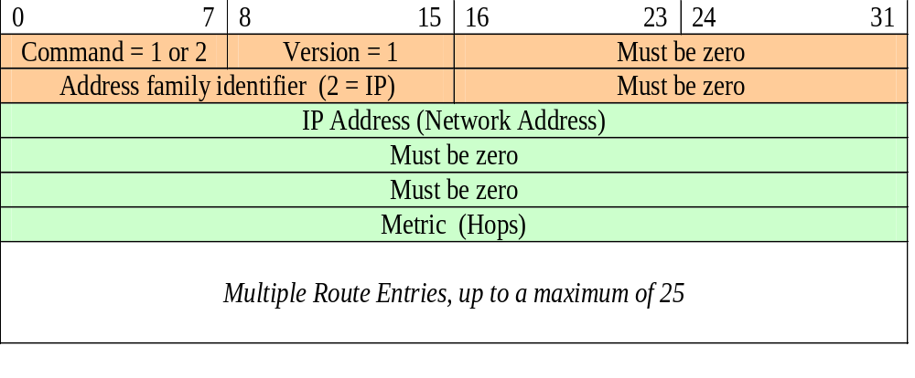
RIPv1 Message Format
Data Link Frame Header
IP Packet Header
UDP Segment Header
RIP Message
(512 Bytes; Up to 25 routes)
Bit
Route
Entry
Notes:
5.1.2-2-B
[Animation]
[Caption] Encapsulated RIP Message
[Notes]
Message format zooms out from the “RIP Message” box
Colors used are not relevant; just make sure the fields are colored differently as shown

Slide 33
RIPv1 Message Format
Data Link Frame Header
IP Packet Header
UDP Segment Header
RIP Message
(512 Bytes; Up to 25 routes)
Bit
Route
Entry
Command: 1 for a Request or 2 for a Reply
Version: 1 for RIP v 1 or 2 for RIP v 2
Address Family Identifier: 2 for IP unless a Request is for the full routing table in which case,set to 0
IP Address: The address of the destination route, which may be a network, subnet, or host address.
Metric: Hop count between 1 and 16. Sending router increases the metric before sending out message.
Notes:
5.1.2-2-C
[Animation]
[Caption] Encapsulated RIP Message
[Notes]
Field Descriptions appear beneath Message format
Final State

Slide 34


Slide 35
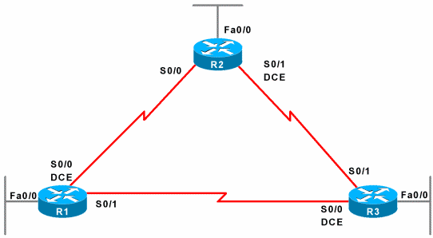
Topology: Scenario A
RIP enabled on all routers
192.168.3.0/24
.1
.2
.2
192.168.2.0/24
192.168.4.0/24
192.168.1.0/24
192.168.5.0/24
.1
.1
.1
.1

Slide 36
Interface Configurations
R1
interface FastEthernet0/0
ip address 192.168.1.1 255.255.255.0
!
interface Serial0/0
ip address 192.168.2.1 255.255.255.0
clockrate 64000
!
R2
interface FastEthernet0/0
ip address 192.168.3.1 255.255.255.0
!
interface Serial0/0
ip address 192.168.2.2 255.255.255.0
!
interface Serial0/1
ip address 192.168.4.2 255.255.255.0
clockrate 64000
R3
interface FastEthernet0/0
ip address 192.168.5.1 255.255.255.0
!
interface Serial0/1
ip address 192.168.4.1 255.255.255.0
Don’t forget: no shutdown

Slide 37
Verify
R1#show ip inter brief
Interface IP-Address OK? Method Status Protocol
FastEthernet0/0 192.168.1.1 YES manual up up
Serial0/0 192.168.2.1 YES manual up up
R2#show ip inter brief
Interface IP-Address OK? Method Status Protocol
FastEthernet0/0 192.168.3.1 YES manual up up
Serial0/0 192.168.2.2 YES manual up up
Serial0/1 192.168.4.2 YES manual up up
R3#show ip inter brief
Interface IP-Address OK? Method Status Protocol
FastEthernet0/0 192.168.5.1 YES manual up up
Serial0/1 192.168.4.1 YES manual up up

Slide 38
Enabling RIP
R1#
R1#conf t
Enter configuration commands, one per line. End with CNTL/Z.
R1(config)#router ?
bgp Border Gateway Protocol (BGP)
egp Exterior Gateway Protocol (EGP)
eigrp Enhanced Interior Gateway Routing Protocol (EIGRP)
igrp Interior Gateway Routing Protocol (IGRP)
isis ISO IS-IS
iso-igrp IGRP for OSI networks
mobile Mobile routes
odr On Demand stub Routes
ospf Open Shortest Path First (OSPF)
rip Routing Information Protocol (RIP)
R1(config)#router rip
R1(config-router)#
To remove the RIP process: no router rip
Router-mode prompt: (config-router)

Slide 39
Enabling RIP
R1(config)#router rip
R1(config-router)#
R2(config)#router rip
R2(config-router)#
R3(config)#router rip
R3(config-router)#
Enable RIP on all three routers.

Slide 40
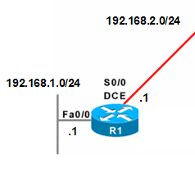
Network Command
R1(config)#router rip
R1(config-router)#network 192.168.1.0
R1(config-router)#network 192.168.2.0
Router(config-router)#network directly-connected-classful-network-address
directly-connected-classful-network-address : Classful major network address of the interface
Network command may include multiple interfaces.
The network command does two things:
  Enables the routing process (RIP) on all interfaces on the router that belong to this network. These interfaces will now both send and receive routing updates (RIP) updates.
  Includes this network or subnets if the interface is a subnet of the network, in routing updates sent to other routers.

Slide 41
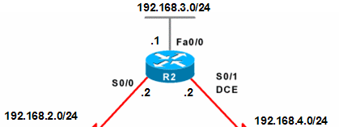
Network Command
R2(config)#router rip
R2(config-router)#network 192.168.2.0
R2(config-router)#network 192.168.3.0
R2(config-router)#network 192.168.4.0
Network command on R2.
Note: If a subnetted-address or interface address is used, IOS will modify it to the classful network address.
network 192.168.2.2 the router will convert it to network 192.168.2.0.

Slide 42
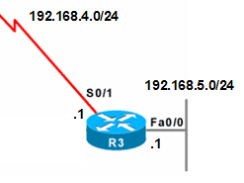
Network Command
R3(config)#router rip
R3(config-router)#network 192.168.4.0
R3(config-router)#network 192.168.5.0
Network commands on R3.

Slide 43
Verify: Running-config
R1#show running-config
Building configuration...
!
router rip
network 192.168.1.0
network 192.168.2.0
!
If a subnet or interface address was used in the network command, IOS will always convert it to the classful network address.

Slide 44
Verify: Routing Table
R1#show ip route
Codes: C - connected, S - static, I - IGRP, R - RIP, M - mobile,
R 192.168.4.0/24 [120/1] via 192.168.2.2, 00:00:10, Serial0/0
R 192.168.5.0/24 [120/2] via 192.168.2.2, 00:00:10, Serial0/0
C 192.168.1.0/24 is directly connected, FastEthernet0/0
C 192.168.2.0/24 is directly connected, Serial0/0
R 192.168.3.0/24 [120/1] via 192.168.2.2, 00:00:10, Serial0/0
R1#
Next-hop router
Exit interface
[ Administrative Distance / Metric (hop count) ]
hh:mm:ss since last update
Notice RIP routes.
Notice directly connected networks.

Slide 45
Verify: Routing Table
R2#show ip route
Codes: C - connected, S - static, I - IGRP, R - RIP, M - mobile,
C 192.168.4.0/24 is directly connected, Serial0/1
R 192.168.5.0/24 [120/1] via 192.168.4.1, 00:00:22, Serial0/1
R 192.168.1.0/24 [120/1] via 192.168.2.1, 00:00:19, Serial0/0
C 192.168.2.0/24 is directly connected, Serial0/0
C 192.168.3.0/24 is directly connected, FastEthernet0/0
R2#
R2 Routing Table

Slide 46
Verify: Routing Table
R3#show ip route
Codes: C - connected, S - static, I - IGRP, R - RIP, M - mobile,
C 192.168.4.0/24 is directly connected, Serial0/1
C 192.168.5.0/24 is directly connected, FastEthernet0/0
R 192.168.1.0/24 [120/2] via 192.168.4.2, 00:00:04, Serial0/1
R 192.168.2.0/24 [120/1] via 192.168.4.2, 00:00:04, Serial0/1
R 192.168.3.0/24 [120/1] via 192.168.4.2, 00:00:04, Serial0/1
R3#
R3 Routing Table

Slide 47
R1: Receiving Updates
192.168.3.0 in 1 hops
192.168.4.0 in 1 hops
192.168.5.0 in 2 hops

Slide 48
R1: Sending Updates
192.168.1.0 metric 1
192.168.2.0 metric 1
192.168.3.0 metric 2
192.168.4.0 metric 2
192.168.5.0 metric 3

Slide 49
Passive Interface
R1(config)#router rip
R1(config-router)#passive-interface fa 0/0
R2(config)#router rip
R2(config-router)#passive-interface fa 0/0
R2(config)#router rip
R2(config-router)#passive-interface fa 0/0
X
Passive-interface command allows for routing updates to be received, but none will be sent on that interface.
Used on interfaces where there are no other routers or routers that we do not wish to exchange routing updates with.
Saves bandwidth
Devices do not need to process these Layer 2 and Layer 3 broadcasts.
Possible security risk or incorrect routing information received.

Slide 50
Review: Scenario A
192.168.3.0/24
RIP enabled on all routers
.1
.2
.2
192.168.2.0/24
192.168.4.0/24
192.168.1.0/24
192.168.5.0/24
.1
.1
.1
.1

Slide 51
Review: Scenario A
R1
router rip
network 192.168.1.0
network 192.168.2.0
passive-interface fa 0/0
R2
router rip
network 192.168.2.0
network 192.168.3.0
network 192.168.4.0
passive-interface fa 0/0
R3
router rip
network 192.168.4.0
network 192.168.5.0
passive-interface fa 0/0

Slide 52
RIPv2
RIP Version 2 (RIPv2) is defined in RFC 2453
Classless Routing Protocol
RIPv2 is actually an enhancement of RIPv1’s features and extensions rather than an entirely new protocol.
Some of these features include:
  Next-hop addresses included in the routing updates
  Use of multicast addresses in sending updates rather than broadcasting.
  Authentication option available.

Slide 53
RIPv2
Like RIPv1, RIPv2 is a distance vector interior routing protocol.
Both versions of RIP share the following features and limitations:
  Use of holddown and other timers to help prevent routing loops
  Use of split horizon and split horizon with poison reverse to also help prevent routing loops
  Use of triggered updates when there is a change in the topology for faster convergence
  Maximum hop count limit of 15 hops, with the hop count of 16 signifying an unreachable network.

Slide 54
Classful Routing Protocols and CIDR Supernets
RIPv1 and other classful routing protocols can not support CIDR routes that are summarized routes with a smaller subnet mask than the classful mask of the route.
RIPv1 ignores these supernets in the routing table and does not include them in updates to other routers.
This is because the receiving router would only be able to apply the larger classful mask to the update and not the shorter.
Note: If the 192.168.0.0 static route were configured with a /24 mask or greater, this route would be included in the RIP updates.
The receiving routers would apply the classful /24 mask to this update.

Slide 55
RIPv2
RIPv2 is defined in RFC 2453. Like version 1,
RIPv2 is also encapsulated in a UDP segment using port 520 and can carry up to 25 routes.

Slide 56
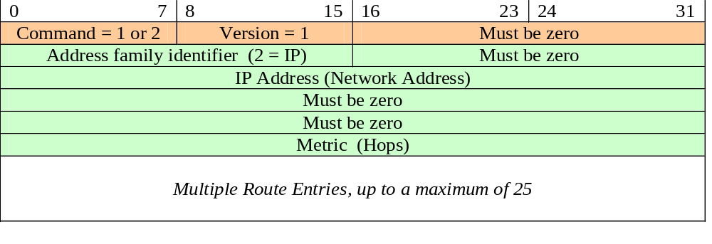
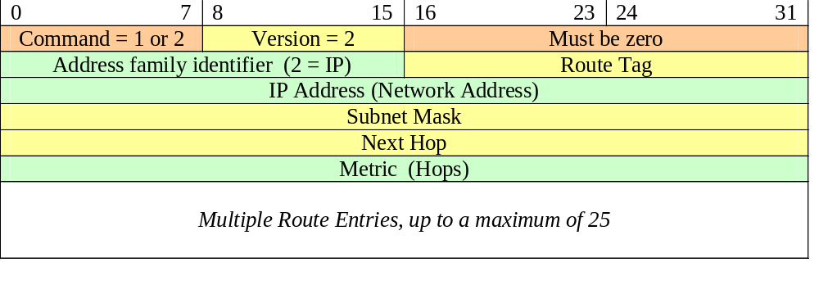
Comparing RIPv1 and RIPv2 Message Formats
RIPv1
Route
Entry
RIPv2
Route
Entry
Notes:
[7.2.1.1]
[static graphic]
[Notes]

Slide 57
RIPv2 Configuration
R1(config)#router rip
R1(config-router)#version 2
R2(config)#router rip
R2(config-router)#version 2
R3(config)#router rip
R3(config-router)#version 2
version 2 command is used to modify RIP to use version 2.
This command should be configured on all routers in the routing domain.
The RIP process will now include the subnet mask in all updates, making RIPv2 a classless routing protocol.
Notes:
[7.2.1.2-B]
[interactive—hotspot]

Slide 58
Restoring RIPv1 Configuration
R1(config)#router rip
R1(config-router)#version 1
or
R1(config)#router rip
R1(config-router)#no version
R2(config)#router rip
R2(config-router)#version 1
or
R2(config)#router rip
R2(config-router)#no version
R3(config)#router rip
R3(config-router)#version 1
or
R3(config)#router rip
R3(config-router)#no version
Notes:
[7.2.1.2-D]
[interactive—hotspot]

Slide 59
Multicast address 224.0.0.9
Notice also that the updates are sent using the multicast address 224.0.0.9.
RIPv1 sends updates as a broadcast 255.255.255.255.
There are several advantages to using a multicast address.
In general, however, multicasts can take up less bandwidth on the network.
Under RIPv2, any device that is not configured for RIP will discard the frame at the Data Link layer.
With broadcast updates under RIPv1 configurations, all devices on a broadcast network like Ethernet must process a RIP update all the way up to the Transport layer, where the device finally discovers that the packet is destined for a process that does not exist.

Slide 60


Slide 61
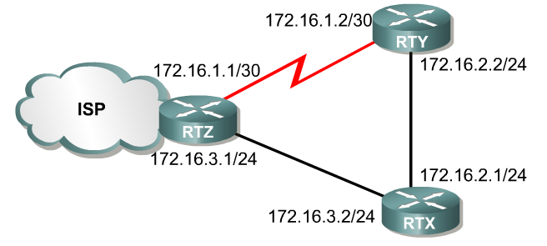

Authentication
R2
R1
I have the valid default route to the Internet!
R3
172.16.5.2/24
172.16.5.1/24
R4
I have a default route to the Internet!
Notes:
[7.4.3.1]
[static]
[Notes]
[CSC: Please check title for this slide - it needed something.]

Slide 62
Authentication
Most routing protocols send their routing updates and other routing information using IP (in IP packets).
The source of an invalid routing updates could be an attacker maliciously attempting to disrupt the network or trying to capture packets by tricking the router into sending its updates to the wrong destination.
Another source of invalid updates could be a misconfigured router.
Or perhaps a host is attached to the network and—unknown to its user—the host is running the routing protocol of the local network.
Whatever the reason, it is good practice to authenticate routing information.
RIPv2, EIGRP, OSPF, IS-IS, and BGP can be configured to encrypt and authenticate routing information.
This practice hides the content of the routing information and routers will only accept routing information from other routers that have been configured with the same password or authentication information.

Slide 63
Summary
Classless IP addressing is implemented with VLSM and CIDR.
The subnet mask is no longer assumed using the value of the first octet of the IP address.
Because the subnet mask cannot be automatically determined by a router by looking solely at the network address, classless IP addressing requires that the subnet mask is included in any routing updates.
A classless routing protocol includes the subnet mask with the network address in the routing update.
Because the subnet mask is included in the routing update, classless routing protocols like RIPv2, EIGRP and OSPF can be used when implementing discontiguous and VLSM networks.

Slide 64
Summary
The inclusion of the subnet mask also allows for the propagation of CIDR supernets, a summarized route less than the classful mask.
RIPv1 is a classful routing protocol, whereas RIPv2 is a classless routing protocol.
Configuring RIPv2 requires adding the version 2 command.
The no auto-summary command is used to disable the automatic summarization of subnets to their classful network address at boundary routers.
By default, auto-summary is the default for RIPv2.
The commands show ip protocols, show ip interface brief, show ip route, show running-config, ping and debug ip rip can all be used to verify and help troubleshoot RIP.

